Slide 1
Acute Toxicity to Drugs &
Drug Induced Liver Toxicity
Patrick McDonnell, PharmD
Professor of Clinical Pharmacy
Temple University School of Pharmacy
Spring 2014

Slide 2

Clinical Toxicology
Intoxication: symptoms of toxicity associated with a chemical substance
Poisoning: adverse effect on the body from a chemical taken in excessive amounts secondary to exposure (usually accidental)
Overdose: an exposure intended to cause self-injury

Slide 3
Epidemiology
  Data from 2006 from the AAPCC (American Association of Poison Control Centers)
    2.4 million poison exposures annually
    600,000 ED visits and hospitalizations
  IOM 2001 Report: 25,000 deaths
  AAPCC 2007 Report: 28,000 deaths
  N.B.: does not include suicide (35,000 annually)
  Drug overdose nationwide secondary leading cause of death due to injury behind MV accidents
    Leading cause of death in 16 states
  Annual costs estimate: “Billions of dollars”

Slide 4
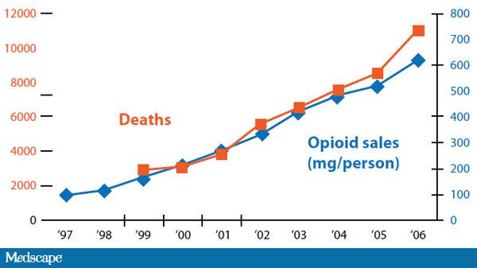

Slide 5

Top Prescribed Drugs 2012
Hydrocodone/acetaminophen: 140 million prescriptions
lisinopril: 70 million prescriptions
simvastatin: 60 million prescriptions

Slide 6
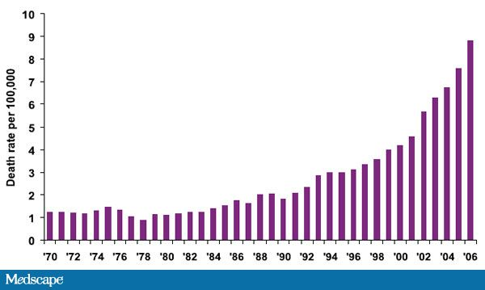
Rate of Unintentional Drug Overdose Death in the US

Slide 7
Poison Deaths
Young adults 25-44: greatest risk
Males 2x > females
Involve carbon monoxide fumes, other gases or vapors, antidepressants, barbiturates, alcohol, opioids
50% of all poison deaths are suicide
1% of deaths are children < 6 yo

Slide 8

Serious Toxicity for Toddlers
(seen with just one mouthful or dosage units—especially in children)
Methanol
Caustics/alkali (Draino, e.g.)
Cationic Detergents
Theophylline
Colchicine
Cyanide
Hydrocarbons
Acids
Hypoglycemic Agents
Clonidine
Chloroquine
Anticholinesterase insecticides

Slide 9
AAPCC-TESS
American Association of Poison Control Centers-Toxic Exposure Surveillance System
Children < 6 accounted for 53% of cases
Site of exposure was the home in 92% of cases
Single substances involved in 92% of cases
93% of cases were acute exposure with 87% being unintentional
Pharmaceuticals are involved in 50% of exposures and make up 75% of serious or fatal poisonings

Slide 10
Poison Exposures
Pediatric | Adult | Fatalities
Medicines | Medicine | Medicine
Personal care items | Cleaners | Alcohols
Cleaners | Bites (insects, snakes, etc) | Gases/fumes
Plants | food | Chemicals
Foreign bodies | Personal Care Items | Auto products

Slide 11
Elderly & Poisonings
Suicidal intent or intentional misuse
Confuse product identity & directions for use
Do not recognize poisoning risk
Co-morbidities complicate toxicity
Unable or unwilling to describe situation
Multiple drugs/polypharmacy

Slide 12
Toxicokinetics
Effect of Overdose | Examples
Slowed absorption due to formulation of poorly soluble concentrations in GI tract | Aspirin, lithium, phenytoin, theophylline- SR
Slowed absorption due to slow GI motility | TCADs, anticholinergics
Slowed absorption due to hypoperfusion from toxins | Procainamide
Decrease serum protein binding | Lidocaine, salicylates, valproic acid, phenytoin

Slide 13
Toxicokinetics
Increased Volume of Distribution | Aspirin (from acidemia)
Slowed elimination due to saturation of biotransformation pathways | Ethanol, phenytoin, aspirin, theophylline, acetaminophen
Prolonged toxicity due to formation of longer acting metabolites | Meperidine, carbamazepine, dapsone, gluthemide
Slowed elimination due to toxin-induced hypothermia ( < 35°C) | Ethanol, propranolol

Slide 14
General Management
Supportive care in “ABCs”
Gather history of exposure
Evaluate clinical presentation: The Toxidrome
Interpret laboratory data
Proceed with appropriate care

Slide 15
Toxidrome Examples
Anticholinergic
  delirium
  hyperthermia
  ileus
  mydriasis
  tachycardia
  urinary retention
  warm, dry skin
Cholinergic
  change in mental status
  bradycardia
  meiosis
  bronchorrhea
  diarrhea/defecation
  salivation
  lacrimation
  urination
  GI cramps and emesis

Slide 16
Immediate First Aid and Decontamination
Respiratory/Inhaled Poison
Poison of the skin
Poisons of the eye
Swallowed Poison: 2-4 ounces of water immediately (unless unable to swallow, convulsions or unconscious); use Ipecac only under advice of poison control center, ED, or physician

Slide 17
Ipecac
Fallen out of favor
No real role in the healthcare setting
Routine home use is not recommended anymore
It should be removed from all homes
Least commonly used method of decontamination

Slide 18
Ipecac
Induces emesis within 15-30 minutes
1-6 episodes lasting up to one hour
Direct stimulation of CNS chemoreceptor trigger zone or direct irritation of the GI tract
Generally used within one hour of ingestion

Slide 19
Ipecac Dosing
6 month-12 months: 5-10 ml
1-12 years: 15 ml
> 12 years: 15-30 ml
Prepare dose with 6-8 ounces of water, juice, or soda
Repeat dose if no emesis within 30 minutes
Adverse Effects
drowsiness, diarrhea, protracted vomiting > 1 hour

Slide 20
Contraindications to Ipecac
Children < 6 months
Patients without a gag-reflex
Ingestion of caustics, corrosives, bleach, ammonia, or sharp objects
Patients who are
  Lethargic
  Comatose
  Convulsing
  Or expected to become unresponsive within 30 minutes

Slide 21
Gastric Lavage
Placement of orogastric tube & washing out gastric contents with fluids
Tap water or normal saline
Tablets must be small enough to fit through tubing (12 mm for adults, 8 mm for children)
Generally used within one hour of ingestion
Alternative for when ipecac is contraindicated
Used in more extraordinary situations

Slide 22
Gastric Lavage
Contraindications
  Ingestion of corrosives, hydrocarbons
  Seizures
  Unprotected airways
Complications
  Aspiration pneumonia
  Laryngospasm
  Esophageal and stomach injury
  Hypothermia
  Fluid/electrolyte imbalance
  Unable to use large enough tube in children < 12

Slide 23
Activated Charcoal
Adsorption prevents absorption
Increase in popularity
Ideally given within first few hours of ingestion
Generally ineffective for iron, lead, lithium, simple alcohols, and corrosives
Dose
  Children < 12 month: 1 g/kg
  Child 1-2 years: 25-50 g
  Adult 50-100 g

Slide 24
Activated Charcoal
Multidose may be used with repeat doses every 2-4 hours at a dose of 0.5 mg/kg
Most useful for drugs that have:
  Low VD: < 11/kg)
  Low plasma binding
  Biliary or gastric secretion
  Active circulating metabolites

Slide 25
Effects of Activated Charcoal
Drug | % Reduction in half-life
Phenobarbital | 62%
Piroxicam | 54%
Phenytoin | 50%
Theophylline | 47%
Carbamazepine | 45%
Nortriptyline | 35%
Propoxyphene | 32%

Slide 26
Whole Bowel Irrigation
Generally reserved when ingestion is several hours after arrival to ED
Some drugs that are not well –absorbed by charcoal or SR or EC drugs
Use for persons who ingest large amounts of illicit drugs for smuggling (drug mules; body packers)
Polyethylene glycol electrolyte solutions
Osmotically balanced solutions administered 4-12 hours causing rectal discharge or drug
Dose: child—250-500 ml/hr; Adults 1-2 l/hr
CI: bowel perforations, obstruction, GI bleed

Slide 27
Antidotes
Use of antidote never replaces good supportive care
Examples:
Glucagon--β-blocker overdose/ CCB overdose
Atropine—anticholinesterases
Digoxin Immune Fab (Digibind)
Dimercaprol; penicillamine: Heavy metal poisons
Calcium EDTA; succimer: Lead
Flumazenil: Benzodiazepines
Naloxone: Opioids
Oxygen: carbon monoxide
Fomepizole or Ethanol: methanol/ethylene glycol
(see list for others)

Slide 28
Select Toxicities
Acetaminophen
Aspirin/Salicylates
Tricyclic Antidepressants
Iron
Cyanide
Calcium Channel Blockers
Lead

Slide 29
Drugs as Xenobiotics???
Xenobiotic--man-made or naturally occurring substance
No nutritional value
Converted to metabolites---excreted
Most liver toxicity from drugs secondary to toxic metabolites

Slide 30
Pharmacokinetic Review
Most drugs are absorbed via GI tract
Distribution
Metabolism/Excretion
  Eliminated Unchanged
  Metabolized by Enzymes
  Undergo spontaneous chemical transformation
  Simply not eliminated

Slide 31
Biotransformation
Lipophilic drugs----Hydrophilic compounds
Phase I metabolism: oxidized or demethylated by Cytochrome P450
Phase II metabolism--make more polar/water soluble
  enzymes that conjugate metabolites to:
    glucoronic acid~glucoronyl transferase
    glutathione~glutathione S-transferase
    sulfate~sulfotransferases

Slide 32
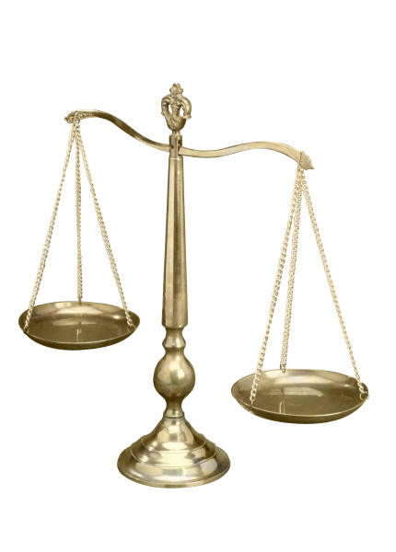
Cytochrome P450
  Major Enzymes Responsible for:
  Safe Routes of Xenobiotic metabolism
  Production of potentially toxic metabolites

Slide 33
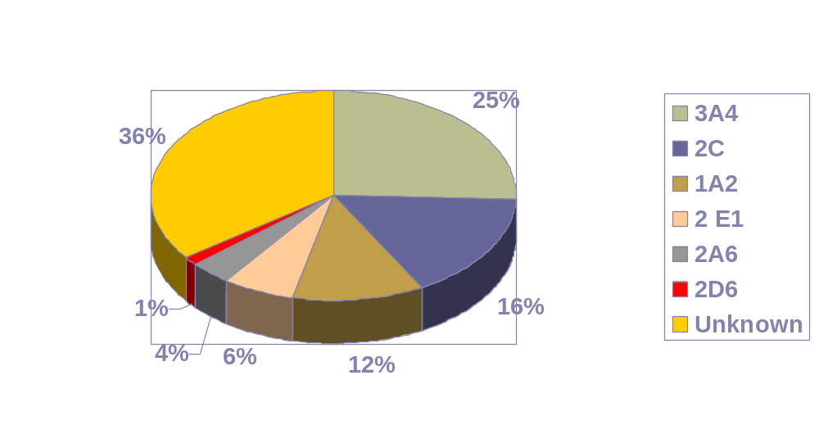
Abundance of Cytochrome P450 Isoenzymes

Slide 34
Metabolism
Phase I
(Toxification)
Phase II
(Detoxification)
Drug
Active Metabolite
Conjugate
Cytochrome P450
GSH transferases
Glucoronidases
Hepatic Injury

Slide 35
Resilient, Yet Vulnerable
Well equipped to resist toxic insults
  Cell cooperation, acute-phase response, synthesis of hepatoprotectants
Vulnerable…expose to toxins in there most reactive forms
  Oral drugs enter portal circulation and undergo first pass metabolism
  Liver structure allows for close contact of drugs
    Hepatic sinuses
    Fenestrated hepatic endothelium
    Enhanced overall surface area of hepatocytes

Slide 36

Toxic Metabolites & Liver Damage
Covalent Binding to Proteins
Creation of Oxidative Stress
Stimulation of an Immune Attack

Slide 37

Pathogenesis--Hepatic Necrosis
Most Common Reaction Type
Formation of Covalent Bond Between Reactive Metabolite and hepatocellular proteins/DNA
Acetaminophen--Prototype Example

Slide 38
Acetaminophen Toxicity
Epidemiology
One of the most common agents involved in overdose by the AAPCC
Most common cause for liver transplants in the UK
Second most common cause for liver transplants in the US
Most common cause of acute hepatic in the US surpassing viral hepatitis

Slide 39
Acetaminophen Toxicity
Epidemiology
When treated promptly and appropriately most patients do not suffer significant hepatotoxicity
4% with acetaminophen hepatotoxicity go onto fulminate hepatic failure
  fatalities and liver transplants needed for half of this subset
40,000 to 45,000 cases of acetaminophen toxicity annually in the US
In 2010, documented over 70,000 cases of acetaminophen overdoses requiring emergent care!

Slide 40
Acetaminophen
O
O
HN-C-CH3
HN-C-CH3
O
HN-C-CH3
UDP-glucoronsyl-transferase
SO4
Sulfotransferase
Glucoronate
O
OH
HN-C-CH3
O
CYP 2E1
HN-C-CH3
O
GSH
s-protein
N-C-CH3
OH
SG
OH
Covalent Binding
Glutathione-S- transferase
NAPQI
O

Slide 41
Acetaminophen Metabolism
Primarily Phase II
Small Fraction Phase I (CYP2E1)
Phase I intermediate--NAPQI
Phase I can increase:
  amount of APAP exceeds capacity of Phase II metabolism
  depletion of glutathione stores
    starvation
    alcohol

Slide 42
Acetaminophen Toxicity
APAP = n-acetyl-p-aminophenol
Toxic dose
  Acute Child--140 mg/kg
  Adults (non-intentional overdose)
    General: do not exceed 4 g daily; however hepatotoxicity has resulted from 3-4 g/ day over a period of one year
    Hepatotoxicity also seen with dosing of 5-8 g/ day over a period of 2 months
    7.5 g can deplete glutathione over 4 days
    10-15 g can deplete glutathione in one day
  Alcohol-Acetaminophen Syndrome

Slide 43
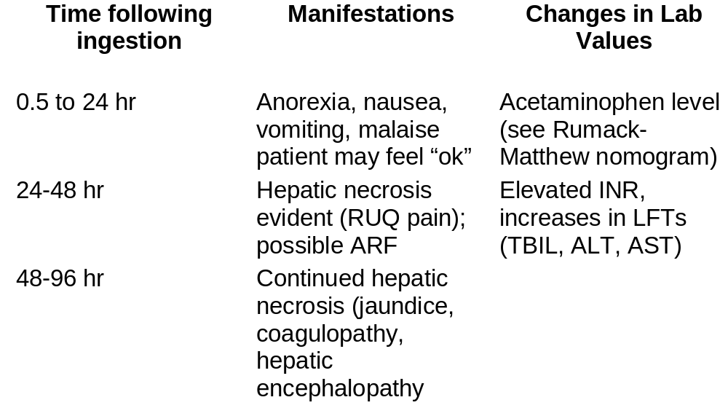
Acetaminophen Toxicity

Slide 44
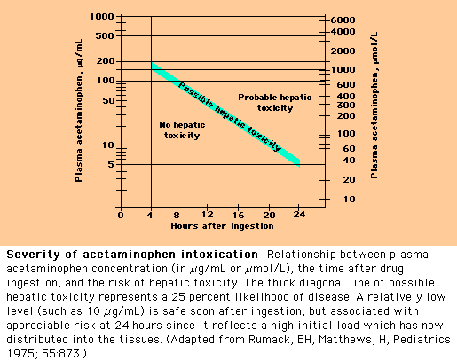

Slide 45
Antidote--N-acetylcysteine (NAC)
Serves as a sulfhydryl donor--substituting for gluthathione
Dose: 140 mg/kg orally diluted in juice or soda. Then give 70 mg/kg q4h x 17 doses.
???IV NAC– was not FDA approved due to lack of pyrogen free product
  off-label dose: 300 mg/kg NAC IV over 20 hours with micropore filtration
Now FDA approved: Acetadote brand IV
  LD: 150mg/kg over 15 minutes
  MD: 50 mg/kg over 4 hours then 100 mg/kg over 16 hours
  This is for more acute doses of acetaminophen

Slide 46
2009 FDA Panel Advisory Recommendations on Acetaminophen
Why restrict acetaminophen?
  Cause 42,000 hospitalizations annually from APAP overdose
  200-400 fatalities

Slide 47
June 30, 2009 FDA Panel Recommendations
Decrease the maximum daily dose of acetaminophen from 4 g to 2.6 g
  Tylenol ES labeling limit to 3 gram daily
Unbundle combination narcotics that contain acetaminophen
  FDA panel recommends in Fall of 2013 to make hydrocodone/acetaminophen CII nation-wide
  500 mg of acetaminophen to be maximum dose in a combination narcotic pill
  Darvocet removed from the market
Limit single doses to 650 mg; doses such as 1000 mg (i.e. 2 ES-Tylenol) would require Rx
Create 325 mg tablet as the standard dosing form as an OTC product
Standardize dosage forms in children to one standard concentration
  DONE
Safer daily dosing for patients with chronic liver disease and concomitant use with alcohol

Slide 48
Changes Proposed
Limit of acetaminophen in prescription drugs: 500 mg per dose.
  This includes all products including combination products (particularly opiates and opioids)

Slide 49
Discussion
What can you do as a future pharmacist to reduce the risk of your patients from developing acetaminophen toxicity?

Slide 50
Salicylates
Aspirin: acetylsalicylic acid
Trilisate: choline magnesium tirsalicylate
Arthopan: choline salicylate
Doan’s: magnesium salicylate
Aspirin for many years was most common cause of unintentional poisoning and poisoning deaths in the Unites States.

Slide 51
Mechanism of Salicylate Toxicity
Increase the sensitivity of respiratory centers in the brain to changes in oxygen and carbon dioxide
  increase rate and depth of respiration
  results in respiratory alkalosis
  increase bicarbonate excretion and diminish buffering capacity

Slide 52
Mechanism of Toxicity
Uncoupling of oxidative phoshorylation
  unable to generate high-energy phosphates
  increase the rate of metabolism (oxygen consumption, glucose utilization, and carbon dioxide and heat production)

Slide 53
Mechanism of Toxicity
Increase demand for peripheral glucose
  formation of ketoacids
  CNS deterioration
Inhibit key enzymes with the Krebs cycle
  increase levels of pyruvate and lactate
Volume depletion
  insensible water loss, vomiting, osmotic diuresis
  electrolyte disturbances
  decrease renal function
Inhibit hepatic synthesis of clotting factors, as well as ASA blocking platelet aggregation

Slide 54
Manifestations
Initial
  vomiting
  sweating
  tachycardia
  hyperpnea
  tinnitus
  lethargy
  confusion
  respiratory alkalosis
  alkaline urine
Progression
  dehydration
  decrease renal fxn
  anion-gap metabolic acidosis
  aciduria
  hypernatremia
  hypokalemia
  hypoglycemia
  prolongation of INR
  cerebral/pulmonary edema
  coma

Slide 55
Salicylate Toxidrome
VS
  hyperventilation
  hyperthermia
Mental Status
  agitation
  lethary
  coma
Symptoms
  tinnitus
  N/V
  confusion
PE
  diaphoresis
  tender abdomen
Lab
  anion gap metabolic acidosis
  respiratory alkalosis
  abnormal coagulation studies

Slide 56
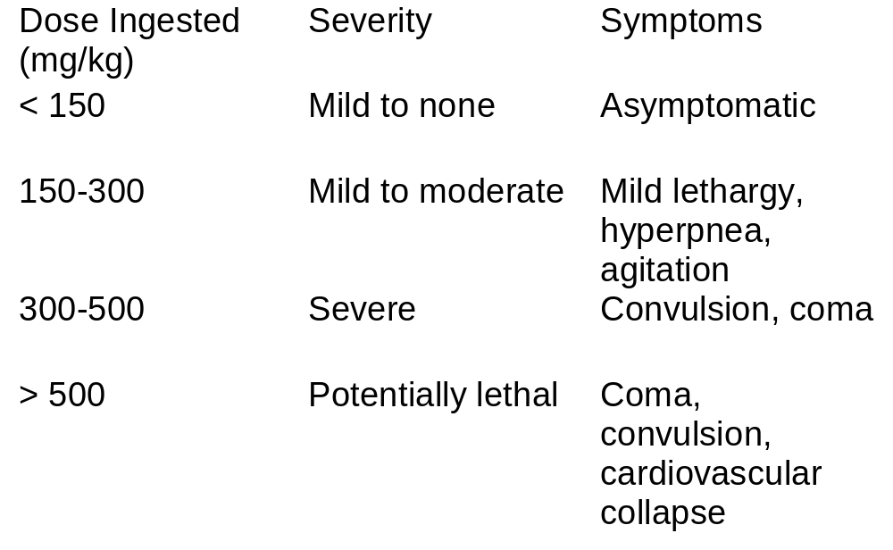
Risk Assessment

Slide 57
Assessment (continued)
Consider dose consumed (mg/kg), patient age, acute vs. chronic ingestion
  chronic intoxication is associated with doses > 100 mg/kg/day for > 2-3 days
Serial serum levels of salicylate should be obtained due to delayed or prolonged absorption (see nomogram)
  plasma levels do not correlate well with chronic intoxication

Slide 58
Treatment
Activated Charcoal
Gastric Lavage vs. Whole Bowel Irrigation
Saline Diuresis and Urinary Alkalization
When to Consider HD

Slide 59
Treatment (supportive)
Treat metabolic acidosis with sodium bicarbonate (will also alkalinize the urine)
Treat electrolyte abnormalities
Seizures (BZDs)
Fluids, oxygen, dextrose, Vitamin K
Cooling blankets for hyperthermia

Slide 60
Tricyclic Antidepressants (TCAD)
TCAD: leading cause of hospitalization and death due to intentional overdose of prescription drugs
  1999 Statistics from AAPCC-TESS
    13,863 exposures
    60% intentional overdoses
    1599 serious events
    101 fatalities

Slide 61
TCAD Toxicokinetics & pharmacology
Possess anticholinergic, α-adrenergic blockade, and adrenergic uptake inhibition
Rapidly and completely absorbed from the GI tract
Cmax 2-8 hours post ingestion
Half-lives: 24-76 hr (prolonged in overdose)
Undergo enterohepatic recirculation
Large Vd 10-20 L/kg; highly protein bound > 95%

Slide 62
TCAD Overdose Manifestations
Cardiac arrhythmias
  Prolong QRS complex with intraventricular conduction delay or bundle –branch block
Hypotension: due to blocking of vascular alpha adrenergic receptors
Anticholinergic
  hyperthermia
  flushing
  dilated pupils
  intestinal ileus
  urinary retention
  sinus tachycardia (also related in inhibition of catecholamine reuptake)

Slide 63
TCAD Toxidrome
PE
  mydriasis
  dry membranes
  distended bladder
  ↓ BS
  flushed
  seizures
Lab
  prolonged QRS
  cardiac dysrhythmia
VS
  tachycardia
  hypotension
  hyperthermia
Mental Status
  confusion, lethargy, dizziness
  coma

Slide 64
TCAD Toxidrome
Can proceed from no symptoms to life-threatening cardiotoxicity or seizures within one hour
Death can occur within hour

Slide 65
Cardiotoxicity
Responsible for mortality with TCADs
Occur with ingestion of more than 1 gram of drug which can lead to plasma levels > 1000 ng/ml
TCAs inhibit fast sodium channel leading to slowing of phase 0 depolarization
results in prolonged QRS/QTc
Potential emergence of re-entry arrhythmias (VT, VF, TdP)

Slide 66
Cardiotoxicity
Sinus tachycardia may predominate with anticholinergic symptoms but hard to distinguish from VT with widened QRS
Also hypotension and pulmonary edema seen
  Hypotension from impaired myocardial contractility and decreased PVR ( α-adrenergic blockade)
  Fluid balance is also key (overload vs. hypovolemia)

Slide 67
Risk Assessment
TCA blood levels generally correlate with severity
< 300 ng/ml “therapeutic”
> 1000 ng/ml severe

Slide 68
Risk Assessment
> 1 gram of ingestion usually results in life threatening toxicity
QRS complex > 100 ms indicators of severe toxicity and seen with blood levels > 1000 ng/ml

Slide 69
Treatment
Aggressive from onset
ABCs
Telemetry
gastric lavage and charcoal
Addition of cathartic
Ipecac contraindicated due to possibility of rapid neurologic deterioration and high risk of seizure
HD no role

Slide 70
Treatment
Sodium bicarbonate is the single most effective intervention for the management of TCA cardiovascular toxicity
Reverses QRS prolongation, hypotension and ventricular arrhythmias
Even effective with normal arterial pH

Slide 71
Treatment of TCAD Overdose
Arrhythmias: Lidocaine is DOC for ventricular arrhythmias
Hypotension: Fluids first; dopamine & other pressors
Seizures: benzodiazepines
Physostigmine?: short acting cholinesterase inhibitor (increase cholinergic tone)
  may overcompensate anticholinergic effects
  suppress supraventricular and ventricular pacemaking leading to severe bradycardia and asystole
  Use with caution; only in patients resistant to standard therapy.

Slide 72
IRON
Iron poisoning can be fatal to both children and adults
92% of exposures were in children < 6
source: usually multivitamins
Elemental Iron
  ferrous sulfate 33%
  ferrous gluconate 12%
  ferrous fumarate 33%

Slide 73
Mechanism of Toxicity
Iron as a GI irritant
  results in hemorrhage and perforation
  excess iron absorption
  fluid & electrolyte imbalances
Acts a mitochondrial poison
  hepatotoxicity
Metabolic acidosis
CV effects
SHOCK

Slide 74
Signs and Symptoms
Stage 1 (< 6 hours)
  N/V/D, abdominal pain, blood in stool or emesis; some acute cases = acidosis/shock
  Stage 2 (6-24 hours)
    decreasing symptoms & improvement of clinical condition, but cannot assume that patient is not moving onto stage 3

Slide 75
Signs & Symptoms (continued)
Stage 3 (24-36 hours)
  CNS--coma, seizures
  hepatotoxicity
  CV shock
Stage 4 (2-6 weeks)
  persistent vomiting, scarring and gastric strictures with permanent dysfunction, liver necrosis

Slide 76
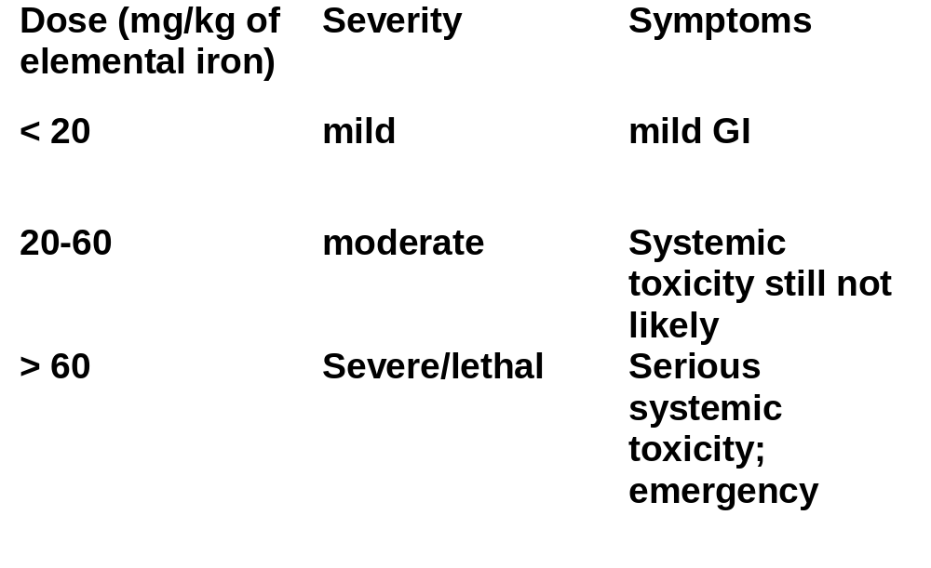
Risk Assessment

Slide 77
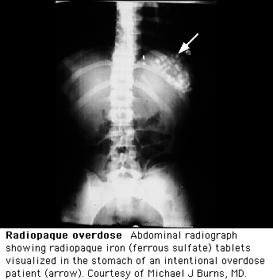
Assessment
Combination of Symptoms
Serum Iron levels
  > 500 mcg/dl high
  < 350 mcg/dl not severe
  glucose and WBC elevation
  Radio-opacities

Slide 78
Treatment
Ipecac
  recent ingestion (< 2 hours) or 10-60 mg/kg of elemental iron
Gastric lavage or whole bowel irrigation
Activate charcoal poorly adsorbs iron
HD does not remove iron
Deferoxamine (chelation therapy)
  systemic symptoms
  serum level > 500 mcg/dl

Slide 79
Deferoxamine Dosing
(IV or IM)
Adults: 1 gram IM followed by 500 mg IM q4h x 2 doses or if needed to max dose of 6 g/day.
Reserve IV route for CV shock
  rate 15 mg/kg/hr IV (do not exceed 6 g/day)
Pseudoallergic reactions
goal at 12 hour : serum iron level of < 350 mcg/dl and resolution of symptoms

Slide 80
Cyanide Toxicity
(sources)
Photography
Electroplating
Metallurgy
Ore refining
Rubber synthesis
Rodenticides
Chemical synthesis
Artificial nail removers
Some fruit seeds
Nitrates (nitroprusside)

Slide 81
Cyanide Toxicity
Toxicity > 3000 cases/year
Mortality > 1000 cases/year
Most common cause: nitroprusside
  free cyanide represents 44% of nitroprusside by weight
  released into bloodstream producing hydrogen cyanide (toxic)

Slide 82
Mechanism of Cyanide Toxicity
Cyanide blocks mitochondrial cytochrome oxidase
Prevents electron transport & oxygen utilization and oxidative metabolism
Ingested cyanide salt can react with HCl to form hydrocyanic acid (lethal

Slide 83
Mechanism of Cyanide Toxicity
A healthy person can eliminate cyanide hepatically at a rate = to cyanide production during a nitroprusside infusion of ~ 2 mcg/kg/min.
The presence of hepatic (cyanide elimination) or renal (thiocyanate elimation ) impairment predisposes a patient to cyanide toxicity

Slide 84
Mechanism of Cyanide Toxicity
In renal impairment patient accumulate thiocyanate
  thiocyanate causes a neurotoxic syndrome
  can also suppress thyroid function
  General monitor of thiocyanate levels
    renal disease
    nitroprusside infusion exceed > 3-4 days
    If thiocyanate level > 20 mg/dl; discontinue therapy
    Thiocyanate can be removed by HD in emergencies

Slide 85
Cyanide Blood levels
< 0.02 mg/dl: asymptomatic
0.05-0.1 mg/dl: flushing & tachycardia
0.1-0.25 mg/dl: obtundation
0.25-0.3 mg/dl: coma
> 0.3 mg/dl: death

Slide 86
Manifestation of Toxicity
Can begin within seconds of exposure
Burning mouth and throat, agitation, syncope, N/V, headache, diaphoresis, dyspnea, tachycardia, HTN.
Bitter almond odor may be detected on breath
Progress to coma, convulsions, CV shock, death

Slide 87
Treatment of Cyanide Toxicity
Antidote
  amyl nitrite, sodium nitrite, sodium thiosulfate, & oxygen
    nitrites convert hemoglobin to methemoglogin which has a higher affinity to cyanide than oxyhemoglobin
    thiosulfate then reacts with cyanide released from the cyano-methemoglobin to form thiocyanate
    Oxygen reverses the binding of cyanide to cytochrome oxidases

Slide 88
Treatment of Cyanide Poisoning
Drug Information Question
  What is hydroxocobalamin and what is role in cyanide poisoning treatment? Describe dosing and mechanism of action.

Slide 89
β-blockers & Calcium Channel Blockers
Role of glucagon
  Glucagon possesses chronotropic and intropic effects by increasing cAMP
  Promote intracellular reentry of calcium through calcium channels
  Improve bradycardia and hypotension
  Dose 5-10 mg IV bolus followed by infusion of 2-10 mg/hr IV
  Used in combination with calcium gluconate

Slide 90
Beta Blocker Overdose
~10,000 annually in the United States
  600 major adverse events
  10 deaths
Complications
  Excessive beta adrenergic blockade
  Proarrhythmic activity on cardiac conduction
    Membrane stabilizing agents
      Propranolol and acebutolol

Slide 91
Beta Blocker Overdose
Beta Receptors
  Beta 1: primarily in heart muscle
    Activation: increase HR and contractility, AV conduction and decrease in AV node refractioriness
  Beta 2: present in heart but primarily in bronchial and peripheral smooth muscle. Activation = vasodilation and bronchodilation
  Beta 3: found in adipose tissue and the heart
    Activation = catecholamine induced thermogenesis and may reduce cardiac contractility

Slide 92
Beta Blocker Overdose
Competitive antagonism at B1 receptor
  Decreased cellular levels of cAMP
  Decreased myocardial contractility
  Decreased automaticity of pacemaker cells
  Decreased conductivity through AV node
Nonselective blockade
  Bronchoconstriction, impaired gluconeogenesis, decreased insulin release

Slide 93
Beta Blocker Overdose
Drug factors that affect toxicity
  Lipophilicity: highly lipid soluble rapidly cross blood brain barrier into the CNS
    Predisposition for neurologic toxicities (seizure and delirium)
  Membrane stabilizing activity; agents inhibit fast sodium channels that can result in widened QRS intervals and may potentiate other dysrhythmias
    Acebutolol is one such agent and is one of the most toxic beta blockers in overdose; other MSA drugs are propranolol and betaxolol
  Intrinsic sympathomimetic activity (ISA); may demonstrate a partial agonistic effect on the beta receptor site ( less bradycardia, less bronchoconstriction)
  Sotalol: combines beta blockade with class III antiarrhythmic properties…prolongs Action Potential by blocking delayed potassium channels = QT prolongation
  Sustained Release products: delayed onset of symptoms and prolonged duration of toxicity
  Drugs kinetics in general change in overdoses

Slide 94
Beta Blocker Overdose
VERSUS
  Cholinergic agents
  Digoxin
  Calcium channel blocker
  Clonidine

Slide 95
Beta Blocker Overdose
Symptoms occur in within 2 hours and seen in all within six hrs (exception SR products)
Toxidrome: bradycardia, hypotension, mental status changes(delirium, seizure, coma); bronchospasm, hypoglycemia

Slide 96
Beta Blocker Overdose
ABCs
Atropine for emergent bradycardia
  0.5 mg to 1 mg every three to five minutes for total of 0.03 to 0.04 mg/kg dose
Fluids for hypotension
Arrhythmia treatments (sodium bicarbonate, magnesium, ACLS)
Additional therapies
  Glucagon
  IV calcium salts
  Vasopressors
  High dose insulin and glucose infusions
  Lipid emulsion therapy

Slide 97
Beta Blocker Overdose
Glucagon
  More of a first line antidote
    Activates adenylate cyclase and increases cAMP
    This increases the intracellular pool of calcium available for release during depolarization augmenting contractilty

Slide 98
Beta Blocker Overdose
Calcium Salts
  Increasing inotropy
    Calcium gluconate for peripheral access
    Calcium chloride for central access
Vasopressors: Generally not monotherapy or first line as doses are too high to reverse symptoms and can cause arrhythmias

Slide 99
Beta Blocker Toxicity
Insulin and glucose
  For those that are hemodynamically unstable despite other therapies
  Interference with myocyte metabolism in overdose and inhibits pancreatic insulin release further reducing available glucose and diminishing cardiac output, insulin appears to improve inotropy by providing substrate for aerobic metabolism with the myocyte

Slide 100
Beta Blocker Toxicity
Lipid Emulsion Therapy
  Used for lipophilic drug toxicity
    Verapamil, some TCADs, bupivicaine, chlopromazine and some beta blockers
  Mechanism
    Acts as a lipid “sink” surrounding the lipophilic drug molecule and rendering it ineffective
    Also fatty acids from the lipid emulsion provide the myocardium with a ready energy source, thereby improving cardiac function
  Protocols vary for dosing
    1 to 1.5 ml/kg over one minute of a 20% lipid emulsion solution
    Repeat every 3-5 minutes for no response up to three bolus doses
    Continuous infusion 0.25 to 0.5 ml/kg/minute until hemodynamic recovery occurs (generally 30 to 60 minutes)

Slide 101
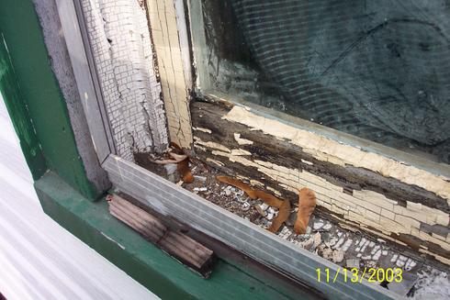
Lead Poisoning

Slide 102
Facts About Lead Poisoning
Lead is ubiquitous in the environment
Lead has no known physiologic value
Estimated that 17% of American pre-school children have abnormally high blood lead levels.
Most cases of lead poisoning are asymptomatic, therefore go untreated.

Slide 103
Facts About Lead Poisoning
LEAD POISONING IS ONE OF THE MOST COMMON AND PREVENTABLE PEDIATRIC HEALTH PROBLEMS TODAY.

Slide 104
Lead Levels of Concern
1960’s: >60 mcg/dl
1978: >30 mcg/dl
1985: > 25mcg/dl
Today: >10mcg/dl
--decreased synthesis of Vitamin D
--correlation of lead levels >10 mcg/dl & decreased IQ scores.

Slide 105
Why children are at higher risks for lead toxicity
GI absorption of lead in children is about 40% versus 10% in adults.
They have more hand to mouth activity
It is estimated that 17% of US pre-school children have lead levels >15 mcg/dl

Slide 106

Philadelphia Lead Facts
Estimated 40% of preschoolers could have elevated BLL
600,000 occupy Philadelphia housing units
95% built before 1978
50% built before 1940

Slide 107

Sources of Lead Exposure
Lead-based Paint: The Most Common Source of Lead Poisoning
Lead is absorbed by the ingestion of paint chips (pica) or by inhalation of lead-tainted dust via renovation or removal of paint from older homes.

Slide 108
Sources of Lead Exposure
Soil & Dust: contamination of soil or dust result from lead-contaminating paint, gasoline, or industrial wastes and smelters.
Frequent hand-washing can reduce lead exposure.

Slide 109
Sources of Lead Exposure
Occupational
Plumbers
Mechanics
Printers
Construction workers
Glass workers
Lead miners
Hobbies
Glazed Pottery
Electronics
Fishing
Stained Glass
Home remodeling
Painting
Target shooting

Slide 110
Sources of Lead Exposure
Food--Either the food itself is contaminated or containers contain lead
Water--can become contaminated with lead from pipes, faucets, or joints. Prolonged contact with hot or acidic water can cause leaching of lead into water.
Folk remedies: Folk remedies that contain lead include alarcon, alkohl, azarcon, bali goli, coral, ghasard, gret, liga, pay-loo-ah, rueda. These remedies are mainly from Arab cultures, Indo-Pakistani cultures, Chinese, and from Latin America.

Slide 111
Lead Pharmacokinetics
Absorption:
Major routes of absorption are GI & respiratory tract.
Competes with Calcium (via calcium transport systems)

Slide 112
Lead Pharmacokinetics
Distribution:
After absorption, lead is distributed initially to soft tissues--especially kidneys & liver
Redistributed to bone, teeth, hair
Nearly all circulating lead is contained in erythrocytes.
Half-life in blood: 1-2 months
Half-life in bones can be up to 20 years!

Slide 113
Effects of Lead Toxicity
Hematologic
Gastrointestinal
Neuromuscular
Central Nervous System
Renal
Other

Slide 114
Heme Synthesis (inhibited by Lead)
Succinyl CoA + Glycine
δ-ALA synthase
δ-ALA
Porphobilinogen
Uroporphobilinogen
δ--ALA dehydratase
Coproporphyrinogen
Ferrochelatase + Fe⁺²
Heme
Protoprophyrin IX

Slide 115

Hematological Effects
One of the earliest manifestation of lead poisoning
Hypochromic, microcytic anemia
Anemia due to decrease heme synthesis & decreased life span of erythrocytes
Levels > 60 mcg/dl, can see basophilic stippling.

Slide 116
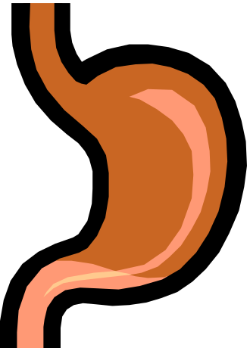
Gastrointestinal Effects
Effects smooth muscle of the GI tract, producing a vague abdominal syndrome
Often an early sign of toxicity
With increase lead levels manifestations include marked constipation and “lead colic”

Slide 117
Neuromuscular Effects
Lead degenerates motor neurons & axons
“Lead Palsy”--seen more in acute toxicity; manifested with wrist & foot drop. This combined with history of exposure is almost pathognomonic for lead toxicity.

Slide 118
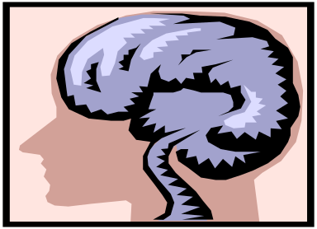
CNS Effects
Levels of 10-15 mcg/dl, correlated with decreased IQ scores.
Early lead exposure @ 12-18 months:
steady loss of motor skills & speech development
learning impairment
hyperkinetic/aggressive behavior disorders

Slide 119
Lead Encephalopathy
Can be seen with lead levels as low as 50; at levels >100, seen in almost all children.
Early signs: clumsiness, vertigo, ataxia, headache, insomnia, irritability
Progressive encephalopathy:
excited/confused behavior
delirium
tonic-clonic convulsions
coma

Slide 120
Renal & Other Manifestations
Renal--can cause ATN
Skin: Ashen color to face & lips
“Lead Line”--blue-black line along the gingival margin
Premature aging syndrome: stooped posture, poor muscle tone, emaciation

Slide 121
Diagnosis
Screening should be done using a BLOOD LEAD LEVEL TEST.
Erythrocyte Protoporphyrin (EP) levels and urinary δ-ALA levels are not sensitive enough to detect lead levels <25 mcg/dl
Abdominal X-ray may show ingested lead particles/objects.

Slide 122
Agents for Treatment
Chelators
Dimercaprol or BAL (British Anti-lewisite)
2 BAL molecules combine with one atom of heavy metal, forming a stable complex that is excreted in urine & feces via bile.
BAL is only available in peanut oil
Used in combination with other chelators
Can only be given by IM ADMINISTRATION!

Slide 123
Dimercaprol (BAL)
Dose: 4mg/kg per dose or 75mg/m² for 5-7 days.
Precautions & Adverse Reactions
Do not use in patients with peanut allergy
Contraindicated in patients with G6PD-deficiency
30% will experience mild, transient side effects: nausea, vomiting, fever, headache, lacrimation & rhinorrhea, transient increase in transaminases.
BAL is a potential nephrotoxin: urine should be kept at pH alkaline

Slide 124
CaNa₂EDTA
CaNa₂EDTA increases the urinary excretion of lead by 20-to 50-fold.
Routes of administration: IM, IV, or SC
Used with BAL when levels >70, or alone with levels <70. (BAL is used only in combination with other chelators.)
ONLY CaNa₂EDTA CAN BE USED IN LEAD POISONING-- Na₂EDTA SHOULD NEVER BE USED.

Slide 125
CaNa₂EDTA
Dose:
Asymptomatic lead toxicity (levels >50) or symptomatic without encepholopathy:
1.5 g/m²/day in divided doses q12h for 5 days.
Symptomatic with encephalopathy or levels >100:
250 mg/ m² four hours after BAL then q4h for five days.
Course can be repeated at 5 day intervals.

Slide 126
CaNa₂EDTA Adverse Effects
Potential Nephrotoxin
Keep patients adequately hydrated
Follow daily BUN/Creatinine
Daily urinalysis for proteinuria or changes in urinary sediment
Hepatocellular damage may occur at end of therapy--reversible in one after discontinuation of treatment.

Slide 127
Penicillamine
Not FDA approved for treatment of lead poisoning.
Dose: 25-35mg/kg/day p.o. in divided doses
Therapy can be several weeks.
Adverse Effects:
Hypersensitivity in PCN allergic patients
Neutropenia, Thrombocytopenia, proteinuria, increased LFTs, N,V, anorexia

Slide 128
Succimer (Chemet®)
Only p.o. FDA approved treatment for lead toxicity
Effective chelator as it is highly selective for lead.
Similar to BAL but it’s water soluble, has a higher therapeutic index, and is absorbed from the GI tract.

Slide 129
Succimer
Dose: 10mg/kg q8h for 5 days followed by 10mg/kg BID for 2 weeks (total days of therapy is 19 days)
(Repeat course can be given @ 2 wk intervals)
Adverse effects: transient increase in LFTs (reversible), N,V,D, anorexia, rash
IMPORTANT: If the home is NOT A LEAD-FREE ENVIRONMENT, succimer CANNOT be used as an out-patient therapy

Slide 130
Chelation Therapy Follow-up
Recheck lead levels @ 7-21 days after treatment
Determine if re-treatment is necessary
Be aware of lead rebound
DO NOT DISCHARGE PATIENT IF LEAD-FREE ENVIRONMENT IS NOT AVAILABLE
Once child is in a safe environment:
Pediatric visits q 2weeks for 6-8 weeks, then monthly for 4-6 month & for remainder of year.

Slide 131


Education of Parents About Reducing Blood Lead Levels
Housekeeping Interventions
Make sure child does not have access to peeling paint.
Home build before 1960 with hard wood floors--wet mop them weekly with high phosphate solution. Also apply this solution on painted surfaces to which child has access.
Wash your child’s hands and face before he/she eats & before bedtime.
Frequently wash pacifiers & toys.

Slide 132
Education of Parents About Reducing Blood Lead Levels
Other interventions
If soil around house is likely to be contaminated, plant grass or other ground cover.
If exterior may be painted with lead-based paint, place obstacles (bushes, trellises, etc.) nearby to prevent access.
Use only fully flushed water from COLD-WATER tap for drinking, cooking, or preparing infant formula.
Do not store food in open cans
Do not use pottery or ceramic ware that was inadequately fired or meant for decorative use.

Slide 133
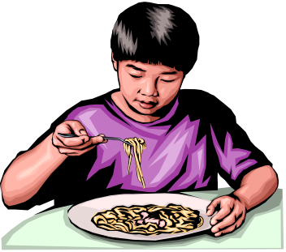




Education of Parents About Reducing Blood Lead Levels
Nutritional Interventions
Make sure child eats regular meals, since more lead is absorbed on an empty stomach.
Make sure your child’s diet contains plenty of iron and calcium.

Slide 134
Screening
The screening schedule is based on the fact that children’s blood lead levels increase most rapidly at 6-12 months and peak at 18-24 months.
Anticipatory guidance on preventing lead poisoning and assessing the risk for high-dose lead exposure should be part of routine pediatric care.

Slide 135
Screening
Question the parent or care-giver about sources of lead--if child is not at high risk for lead exposure, the child should be screened at 12 months, and if resources allow, again at 24 month.
If child is at high risk, the screening process should begin at six months of age.

Slide 136
Conclusions
Lead poisoning remains a major health hazard in the United States.
Role of health care workers is to provide parents with information about major sources of lead, screen children at appropriate intervals, and work in tandem with public health officials in the primary prevention of lead poisoning .

Slide 137
Conclusions
Even though pharmacologic treatments are available to decrease blood lead levels, the mainstay of treatment is to decrease exposure to lead.

Slide 138
FDA November 2013
FDA Investigates Acute Hepatitis Illnesses Potentially Linked to Products Labeled OxyElite Pro
The FDA along with the Centers for Disease Control and Prevention (CDC) and state and local health officials are investigating more than 50 cases of acute non-viral hepatitis. As of October 31, 2013, 56 cases had been identified. Among these cases, 22 people have been hospitalized, two people have received liver transplants, and one person has died.

Slide 139
Hepatotoxicity from Drugs
Prototype really is acetaminophen
Demonstration of hepatic necrosis
But there are other mechanisms of how drugs can effect the liver and liver function
Over 900 drugs have been implicated in reports of hepatotoxicity.

Slide 140
Hepatotoxicity from Drugs
Incidence comprises 6% of all ADR types
Heightened awareness from recent market withdrawal of drugs
Drugs account for 50% of all cases of acute liver failure
  75% of these reactions lead to liver transplantation
Besides acute liver failure, chronic liver failure can result from long term drug exposure.

Slide 141
Hepatotoxicity from Drugs
Involves mechanisms
  hepatocellular injury/hepatic necrosis
  injury to vascular structures
  allergic/idiosyncratic
  cholestatic injury/obstruction of bile flow.

Slide 142
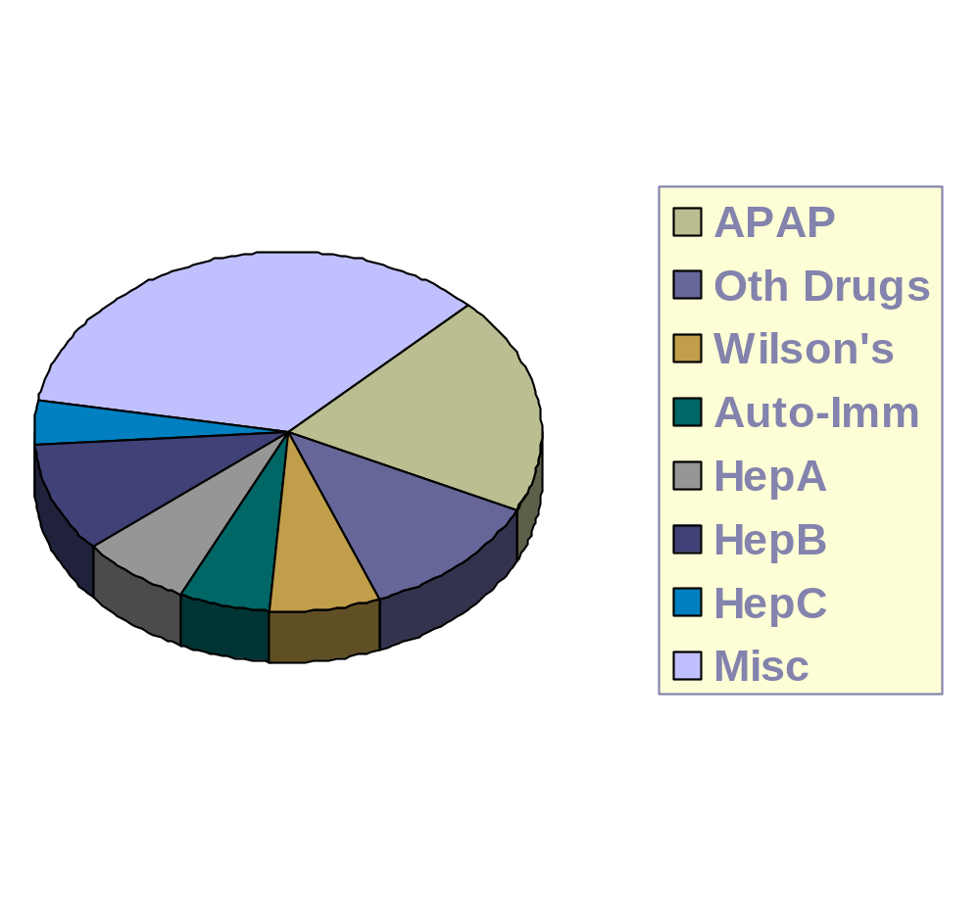
Fulminant Hepatic Failure

Slide 143
Factors & Susceptibility to Drug-Induced Hepatotoxicity
Age
  Adults more susceptible to injury from INH, halothane and acetaminophen
  Children more susceptible to injury from aspirin and valproic acid
Dose: Dose dependent toxicity from drugs that are intrinsic hepatotoxins

Slide 144
Factors & Susceptibility to Drug-Induced Hepatotoxicity
Duration/Total Dose: Methotrexate for autoimmune disease; busulfan for BMT
Tissue hypoxia: enhances the hepatoxicity of direct toxins
Drug interactions
Underlying diseases: hepatic disorders, AIDS, rheumatoid arthritis

Slide 145
Other Mechanisms
Fatty-Liver/Cirrhosis-Like Reaction
  Prototype: Amiodarone
  Acute vs. Chronic toxicity
    Most cases are NOT acute in the sense of the word but occur within months after starting amiodarone
    Biopsy looks like cirrhosis
    Moderately elevated ALT/AST
    Stopping drug, reversibility questionable and can take months???

Slide 146
Cholestatic Reactions
Liver function basically intact
Blockage of bile flow due to drugs
Early jaundice associated with pruritus
Liver Bx: engorgement of canaliculi and other vascular structures with minimal hepatocellular injury
Examples:
  Estrogens, co-trimoxazole, rifampin, naficillin, chlorpromazine, erythromycin
  KNOW THE LABS

Slide 147
Hepatic Veno-Occlusive Disease
Similar to cholestatic but much more severe and serious
Rapidly progressing and abrupt
  Painful hepatomegaly
  Ascites/weight gain > 5% baseline
  Hyperbilirubinemia
  Elevated ALKP; AST
  Encephalopathy
  Mortality can approach 50%

Slide 148
Hepatic Veno-occlusive Disease
Treatment—supportive
  Increase intravascular volume
  Decrease extravascular volume accumulation
  Minimize factors that exacerbate encephalopathy
  Investigational treatments
    TPA
    Prostaglandin E1
  Prophylaxis???

Slide 149
Allergic Hepatitis
Systemic allergic reaction
Fever, rash, lymphadenopathy, eosinophilia
Can result in hepatic necrosis and/or cholestasis
Mimics a viral syndrome
Prototype drugs: phenytoin,
co-trimoxazole

Slide 150
Idiosyncratic Hepatotoxic Reactions
    Usually non-dose related
    Mixed forms of hepatic dysfunction
    Does not involve the immune system
    Seen with agents such as allopurinol, aspirin, sulfonamides, quinidine, HMG-co-reductase inhibitors, valproic acid, INH; probable reactions seen recently with troglitazone and trovafloxacin.

Slide 151
Idiosyncratic Hepatotoxic Reactions--Isoniazid (INH)
Mild increases in transaminases in 20% of people
1-2% fulminant liver damage--may be fatal
See more frequently in:
  patients >35 year old
  concomitant rifampin
  ? Genetic link with slow “acetylators”

Slide 152
Idiosyncratic Hepatotoxic Reactions--Isoniazid (INH)
Routine LFT monitoring not generally recommended
Symptoms of hepatotoxicity warrant evaluating LFTs
  ALT/AST > 500 IU/L--discontinue drug
  Milder elevations--may restart drug when ALT/AST decrease and symptoms resolve

Slide 153
Indolent Cirrhosis--Methotrexate
Seen with chronic use in psoriasis and rheumatoid arthritis
Can develop over several years WITHOUT any evidence of hepatitis or biochemical abnormalities
Key to early diagnosis --liver biopsy
Usually after cumulative dose of 2500 mg of MTX

Slide 154
Reye’s syndrome
Associated with the use of aspirin during the prodromal phase of viral illness
Fatty vacuolization of the liver
  hepatic injury
  vomiting
  hypoglycemia
  progressive encephalopathy

Slide 155
Reye’s Syndrome
Annual Cases in United States between 200-550 from 1974-1984
Today <20 cases annually
Warnings regarding aspirin use in children

Slide 156
Non-prescription Agents & Liver Toxicity
“Natural Products” and Herbal Remedies--presumed safe??????
  Causes of liver damage
    vitamin A
    comfrey
    chaparral
    germander
    jin bu huan
    Oil of clove
    KAVA

Slide 157
Vitamin A
Established cause of liver disease leading to cirrhosis with ascites and portal hypertension
Liver injury with chronic ingestion of megadoses
Usual RDA for Vitamin A is 5,000 IU/day
Toxicity when patients use 15,000 to 40,000 IU/day over a period of years

Slide 158
Kava
Extract from the kava-kava plant: a plant in the pepper family
Touted to reduce anxiety, sleep remedy
Reports of liver toxicity in products containing 30-70% lactones
Lactones from commercial extraction of kava from the roots of plants using ethanol or acetone as solvents
Kava lactones deplete glutathione and toxic kava waste products build up leading to liver disease

Slide 159
Market Withdrawal
List 4 drugs that have been removed from the market in the past two decades specifically due to liver toxicity

